Slide 1
EOSC portal service onboarding
Diego Scardaci – EGI / EOSC-hub & ExPaNDS
Dissemination level: Public

Slide 2
So you want to bring your service to EOSC…
What is onboarding
From who, to where
The meta process
Criteria for inclusion
The SDT (now provider and resource profiles)
Publication, Updating
Next steps

Slide 3
What is ‘onboarding’
Research community
Users
Portals and APIs
Researcher facing resources (exchange)
Service
Data
Onboarding
Provider
Connecting providers and their resources to EOSC such that they can be accessed by researchers and can build over core services
EOSC Core services (internal)
Core service
Core Service provdiers
Core provider
Core resource providers

Slide 4

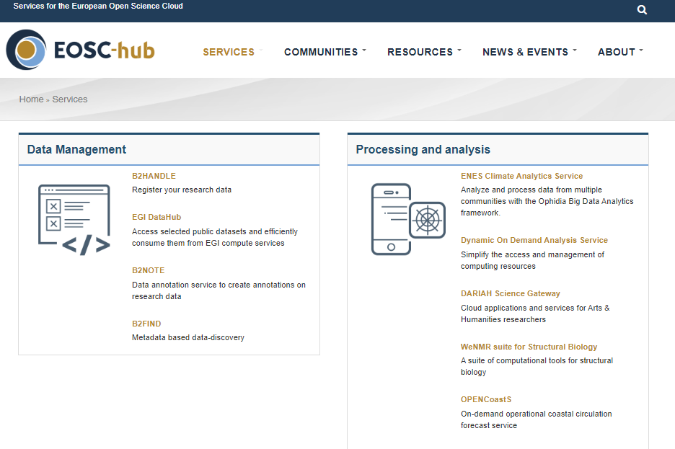
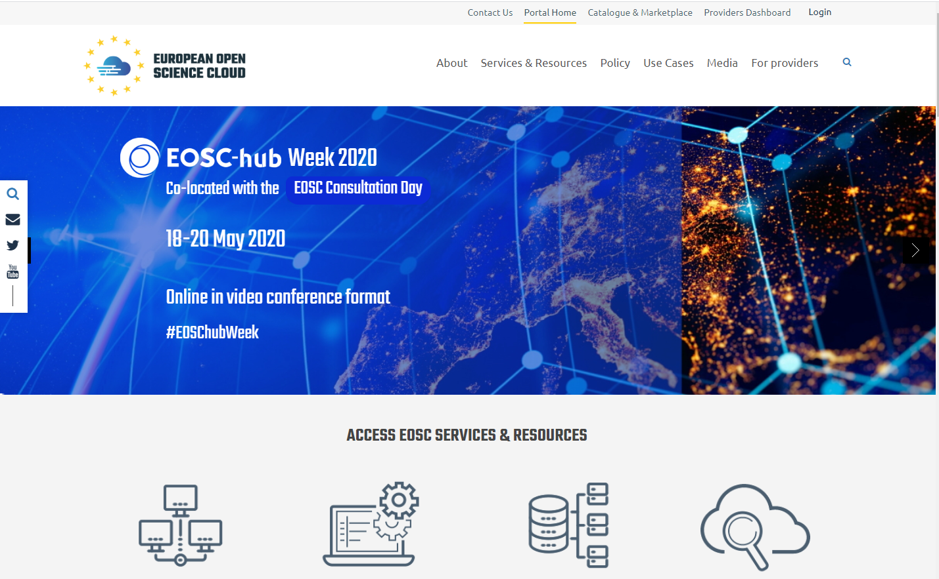
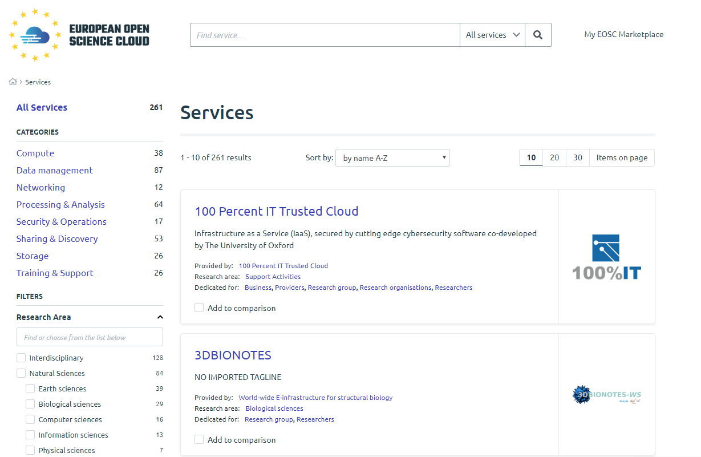

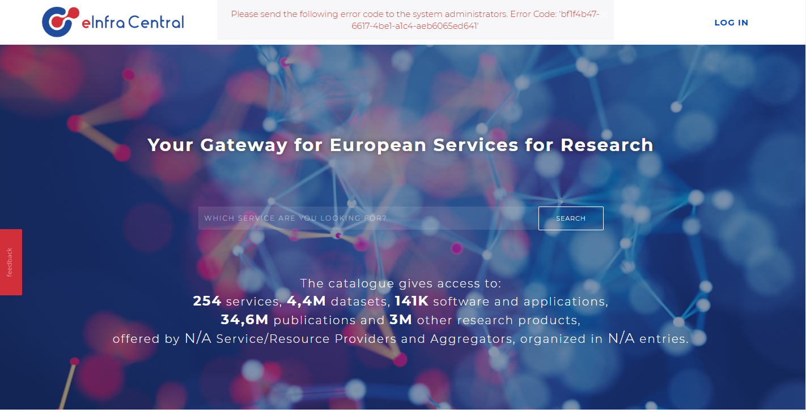










From who, to where?
EOSC hub marketplace
EOSC Portal website
Working now, somewhat messy
eInfraCentral catalogue
Being
launched
EOSC Portal catalogue / marketplace
Planned

Slide 5
The current meta process for providers
https://wiki.eosc-hub.eu/display/EOSC/Service+Provider+Documentation
Fill an offline or online form, or (soon) submit via data via an API
Check of appropriateness of resource and compliance with RoP
Start process by email or a web form
Resource appears in public pages
Submit the request for onboarding
Information gathering
Validation
Validation team examines filled template
Send an email to join@mailman.eosc-hub.eu or fill the form available on the EOSC portal
Publication
Publish the service in the EOSC portal Marketplace
Receive support from EOSC-hub team in filling in the information
Receive a service description template to fill in
Fill the service description template
Ensures the services meets the Rules of Participation
Requests clarifications if required
Enters service in Service Portfolio
Transfer subset of data from the portfolio to the Marketplace on EOSC portal
Provide draft of entry to service provider

Slide 6
Current criteria
The following criteria are those currently used by EOSC-hub to understand which services should be onboarded. These criteria are still under development, by our team in the EOSC-hub project and EOSC Portal collaboration, but also at a larger scale by the EOSC Executive Board appointed by the European Commission. The EOSC Executive Board may define broader criteria in future, but these are the current criteria we are using.
It must be an actual service
It must be a service according to the IT Service Management definition [1]. It should be an ongoing activity offered ‘live’ to customers. This may be an IT service, or a human service (e.g. training, consultancy).
It may not be a research product, for instance, a document, a dataset or a piece of software.
The Service must be coherent. It must be available and offer value on its own. It may not be only a feature of a larger service.
Service must meet at least one of:
The service must be targetted to the research community
The service must be provided by the research community
The service comes from an EOSC related H2020 funded project
The service is part of a procurement framework targeting researchers.
The service must be both available in Europe and available in a European language. See https://europa.eu/european-union/about-eu/eu-languages_en
The required fields in the Service Description Template must be filled, including required linked information.
URLs must be Fully Qualified Domain Names (FQDN)
The provider must agree to periodically update their data to keep it current (to be covered in Provider agreement, TBC)
Key information must be in English
The SDT must be in English
The basic information in the User Interface for the service must be available in English
Privacy statements, terms of use and SLA/SLS must be available in English. Other documentation may be in native language only.
The Helpdesk must be able to answer queries in English at a minimum.
[1] Definition according to FitSM-0 - Service: Way to provide value to customers through bringing about results that they want to achieve Note: In the context of the FitSM standard series, when referring to services, usually IT services are meant. From https://www.fitsm.eu/download/280/

Slide 7
Proposed next version of inclusion criteria
What resources may be connected to EOSC?
Services. At present only services are being onboarded (though this is planned to change in future).
It must be an actual service
It must be a specific service offered ‘live’ to customers [1]. This may be an IT service, or a human service (e.g. training, consultancy).
It may not be a research product, for instance, a document, a dataset or a piece of software [2].
The Service must be discrete. It must be available and offer value on its own. It may not be only a feature of a larger service available while already using that service .
Services must meet at least one of:
The service must be targeted to EOSC and EOSC communities [3].
The service must build on or leverage EOSC capabilities to serve some other community.[4]
Research products (Rules TBD)
A provider profile and resource profiles for each resource must be filled, including all required fields.
URLs must be Fully Qualified Domain Names (FQDN)
Key information must be in English
The provider and resource profiles must be in English
The basic information in the User Interface for the service must be available in English
Privacy statements, terms of use and SLA/SLS must be available in English. Other documentation may be in native language only.
The Helpdesk must be able to answer queries in English at a minimum.
Resources must be both available in Europe and available in a European language [5].
The provider must agree to periodically update data on themselves and their resources to keep it current (to be covered in Provider agreement, TBD)
[1] Filling e.g. the definition according to FitSM-0 - Service: Way to provide value to customers through bringing about results that they want to achieve. Note: In the context of the FitSM standard series, when referring to services, usually IT services are meant. From https://www.fitsm.eu/download/280/ It should not be a generic menu of services from a provider, but the specific services themselves.
[2] A data repository service providing some annotation, tools over the data sets, enhanced features is likely a service. A simple link to a data file is not.
[3] For instance, could be a service from the research community for researchers, or if a commercial service, includes a clear offer targetted at EOSC and research customers which addresses them, rather than be a generic commercial service. One example of the latter is a joint procurement framework targetting EOSC.
[4] For instance, services through the Digital Innovation Hubs which build on EOSC expertise, resources and capabilities to create new, innovative commercial services
[5] See https://europa.eu/european-union/about-eu/eu-languages_en

Slide 8
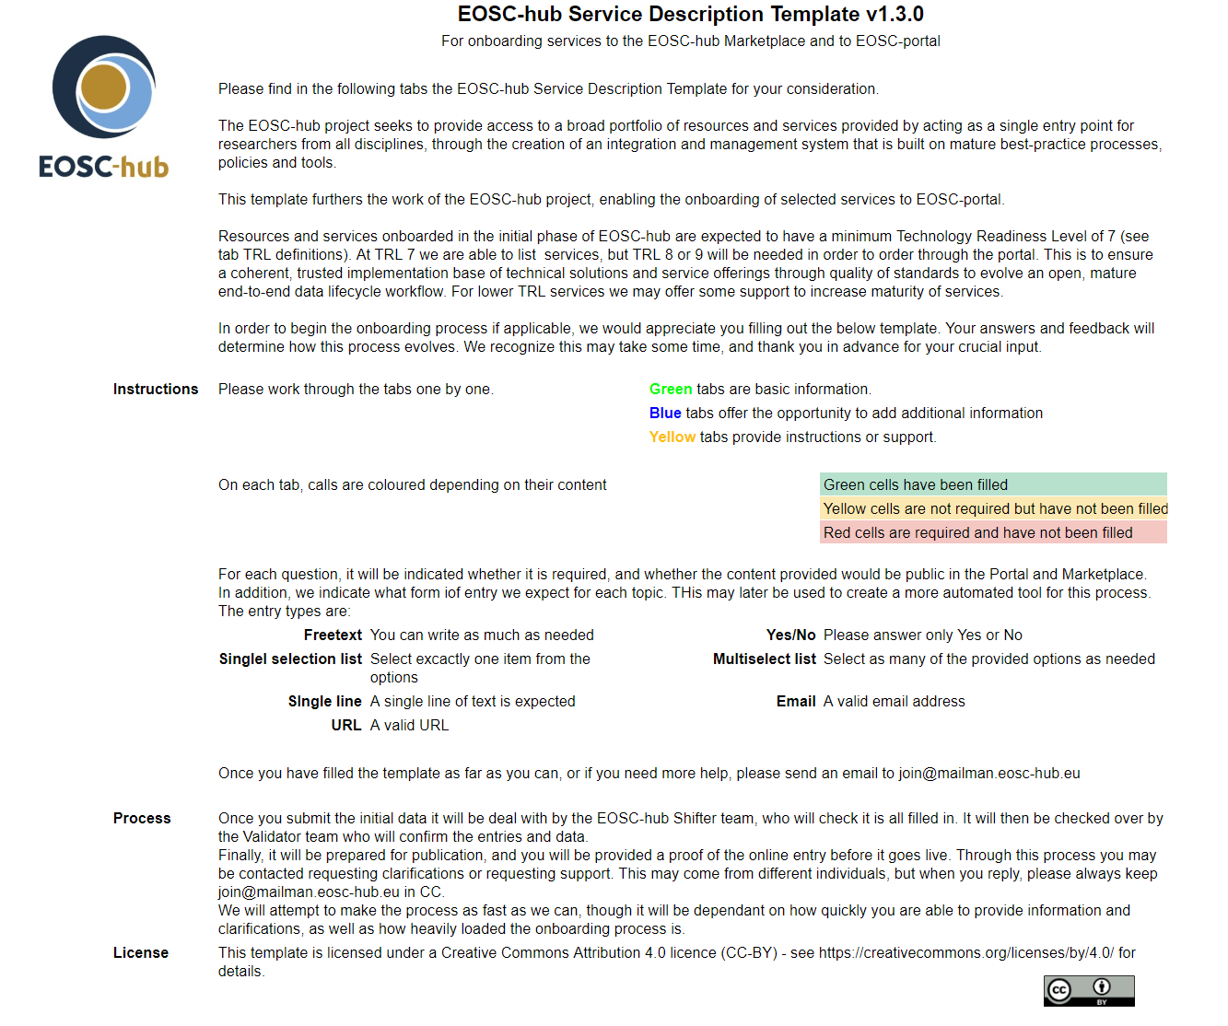
The current Service Description Template
The file you are asked to fill to provide information to EOSC-hub
Current version, 1.3.0
Data on providers and the resources they want to onboard (Services for now)
Quite large set of data
Mix of required and optional
Assistance in the file
FOLLOW ALONG: bit.ly/EOSC-SDT-DEMO

Slide 9
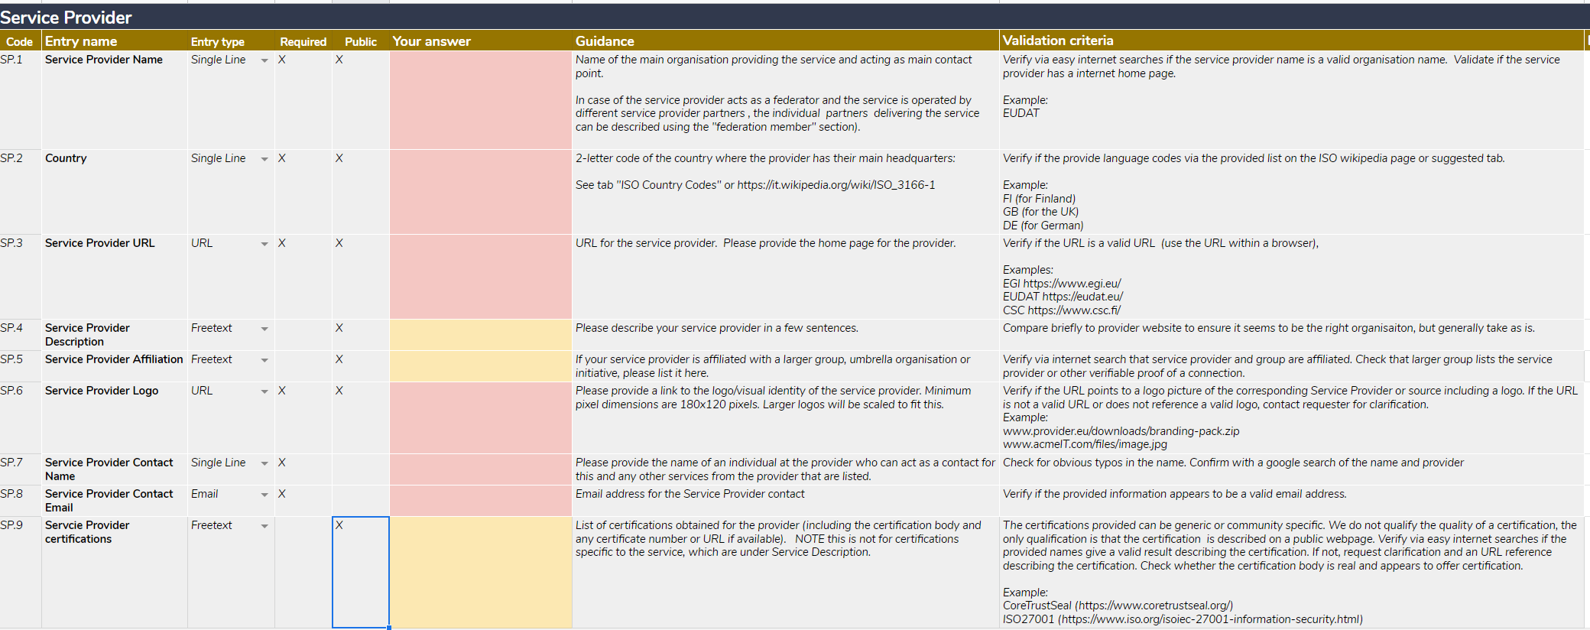
Service Provider
View the SDT: bit.ly/EOSC-SDT-DEMO
Notes:
Highlights
-Affiliation
-Contacts
-Certifications

Slide 10
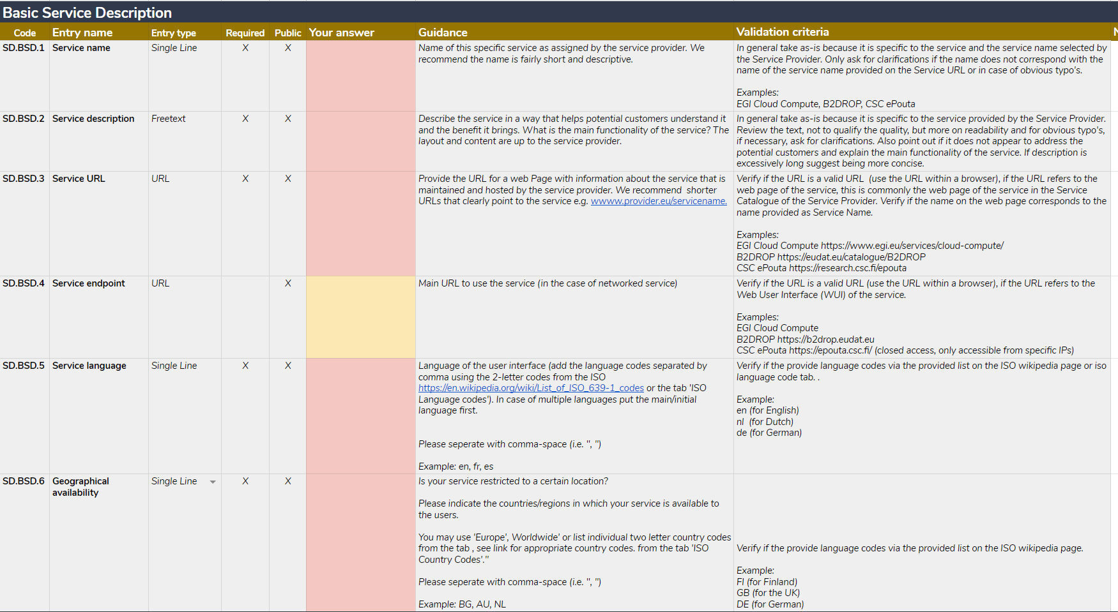
Service Description 1
View the SDT: bit.ly/EOSC-SDT-DEMO
Notes:
Highlights:
- Language and availability → validation

Slide 11
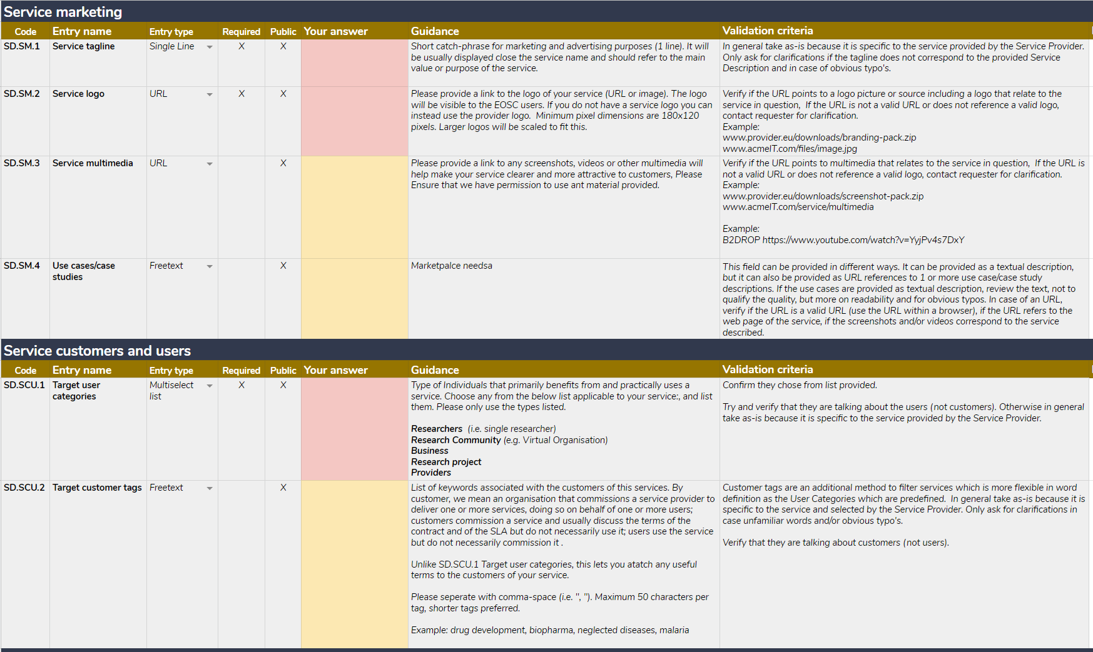
Service Description 2
View the SDT: bit.ly/EOSC-SDT-DEMO
Notes:
Highlights:
Tagline and logo → How the service is seen
Multimedia and case studies → show richer content about your service
Customer tags deal with limitations of categorisation#

Slide 12
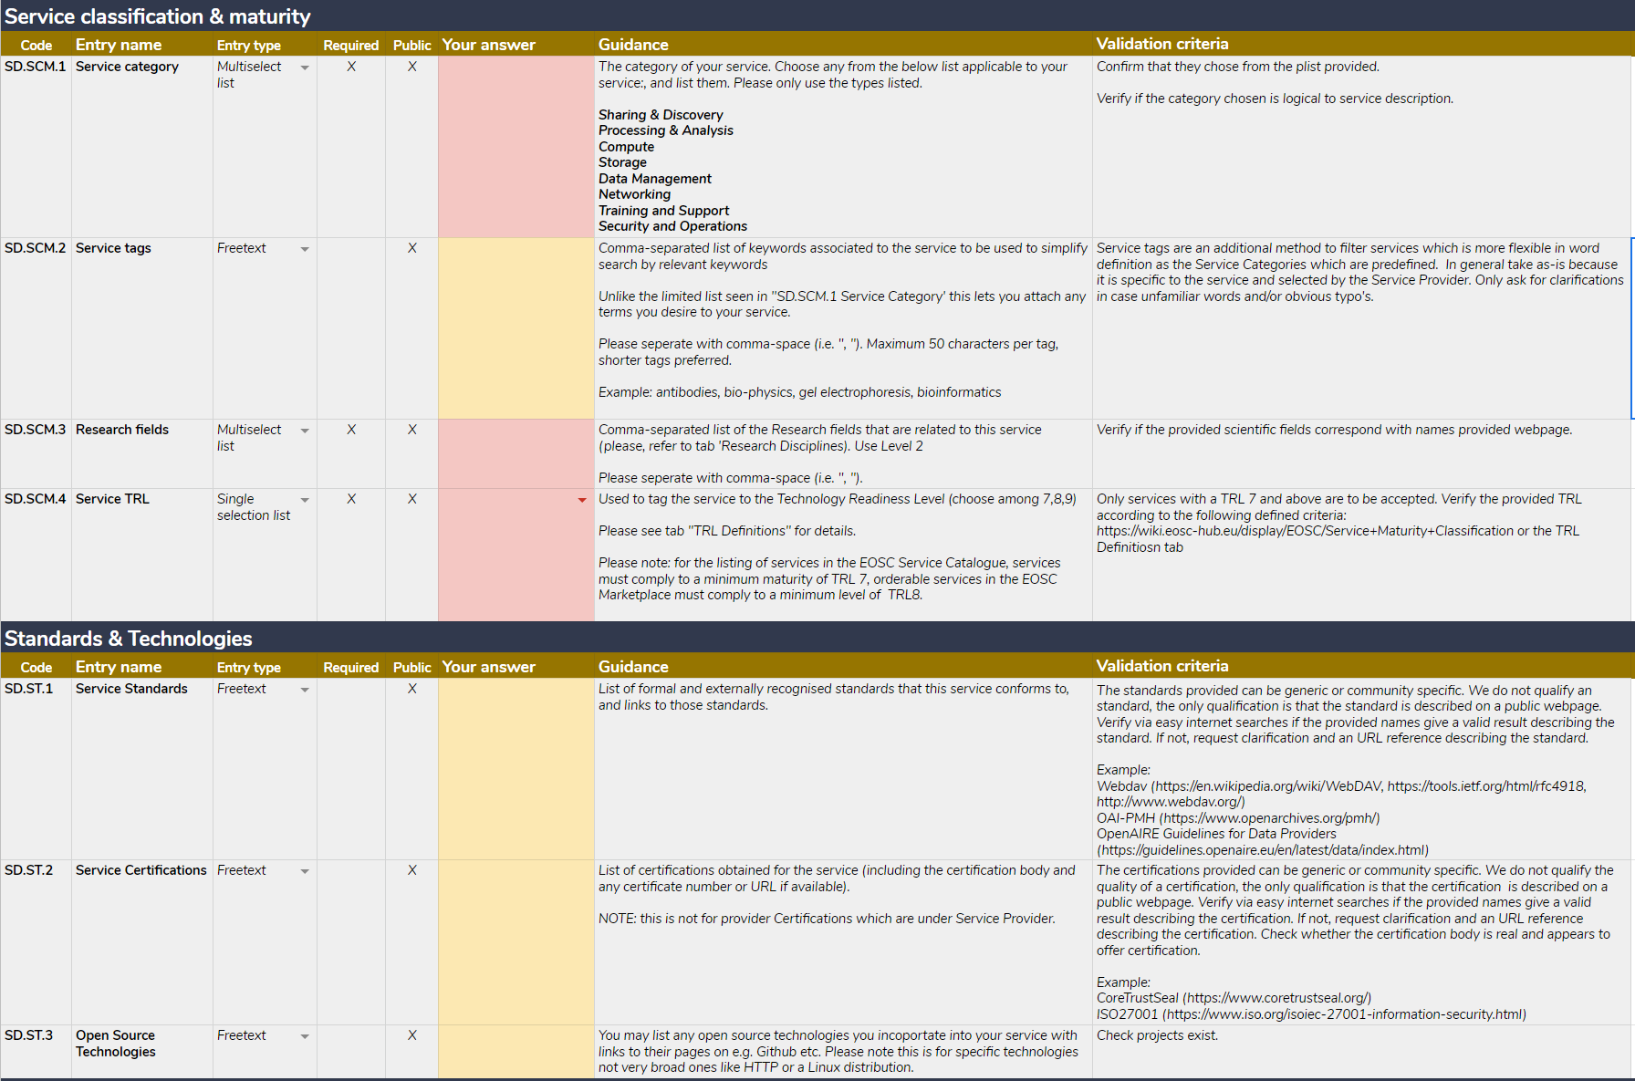
Service Description 3
View the SDT: bit.ly/EOSC-SDT-DEMO
Notes:
Highlights:
Category and tags: like users, support categories and free choice of terms
Research fields – Frascati modified
TRL – the problem of definition, mapping to lifecycle phases, the need for a shared set of criteria for TRLand phases, how to validate

Slide 13
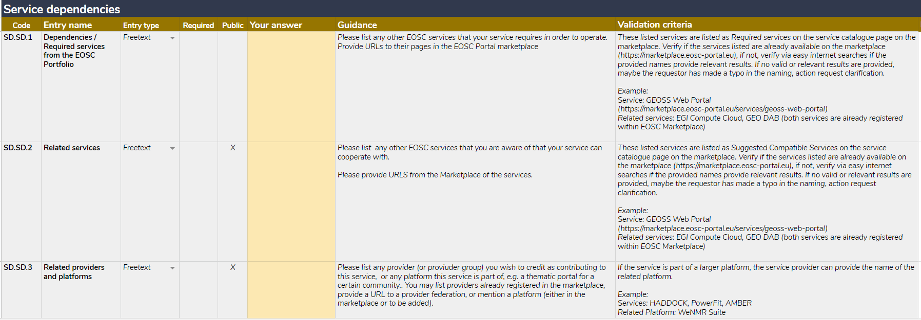
Service Description 4
View the SDT: bit.ly/EOSC-SDT-DEMO
Notes:
Highlights:
Relationships between services, in Agora this is a relationship not a field, example of improvements.
All optional

Slide 14
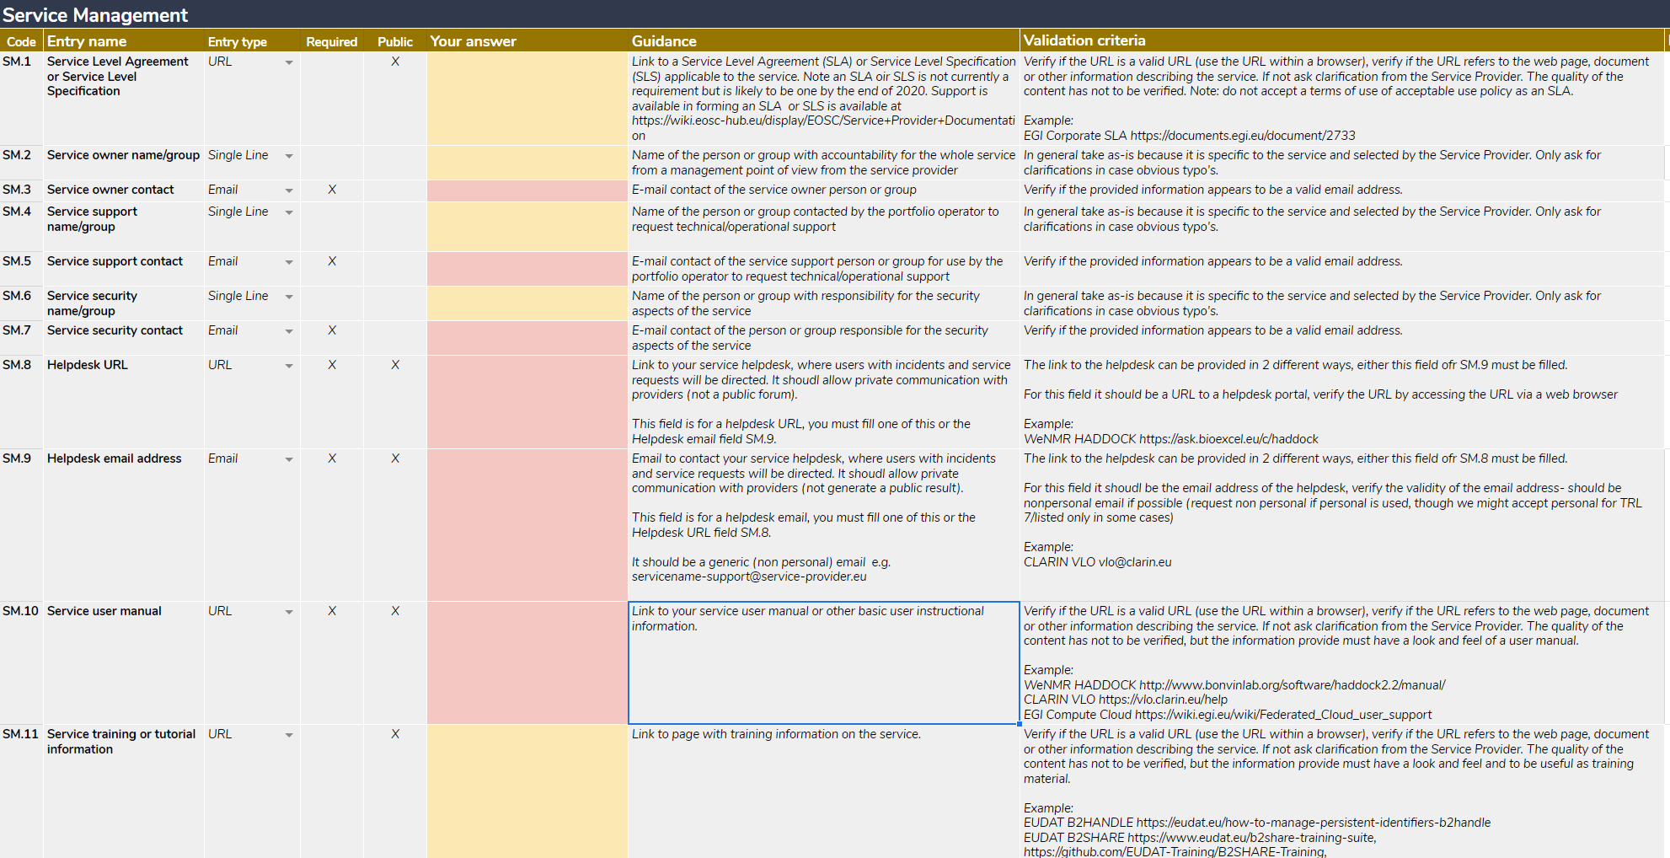
Service Management 1
View the SDT: bit.ly/EOSC-SDT-DEMO
Notes:
Highlights:
Increasing maturity of services, asking them to provide material which makes them better providers
Importance of contacts
Importance of a helpdesk
SOME sort of user support, to be discussed

Slide 15
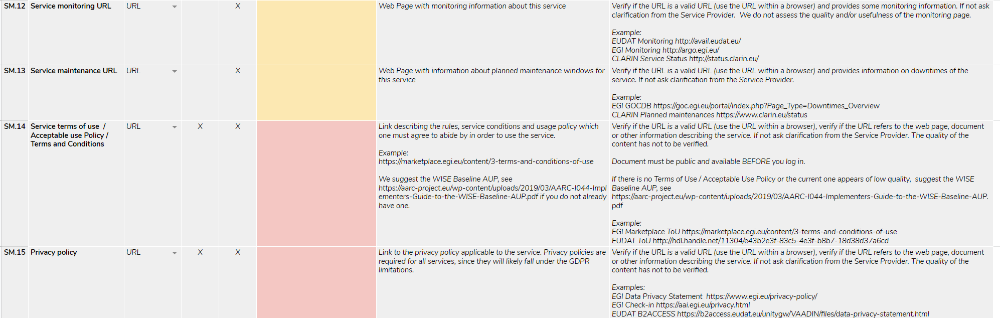
Service Management 2
View the SDT: bit.ly/EOSC-SDT-DEMO
Notes:
Highlights:
Monitoring → relate to quality
AuP / ToU, make sure users are informed about their responsibilities
Privacy policy in the age of GPDR

Slide 16
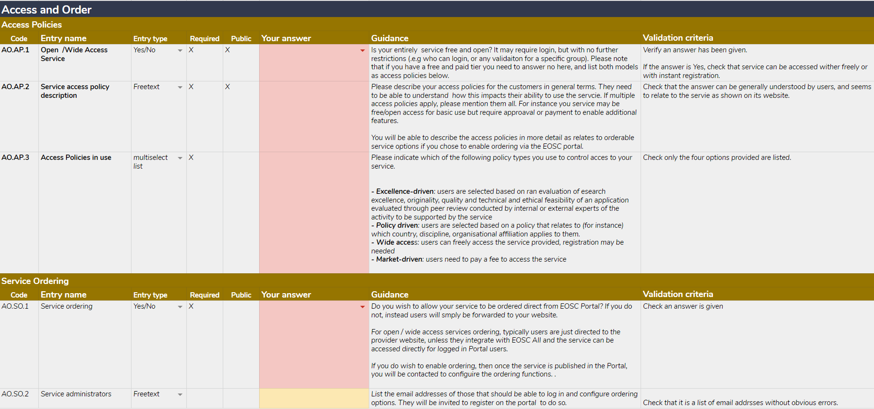
Access & Order
View the SDT: bit.ly/EOSC-SDT-DEMO
Notes:
Highlights:
- Clarify to users who can access the service, under what conditions
Added value of EOSC, support ordering via the portal (s)
Set up ordering in the marketplace

Slide 17
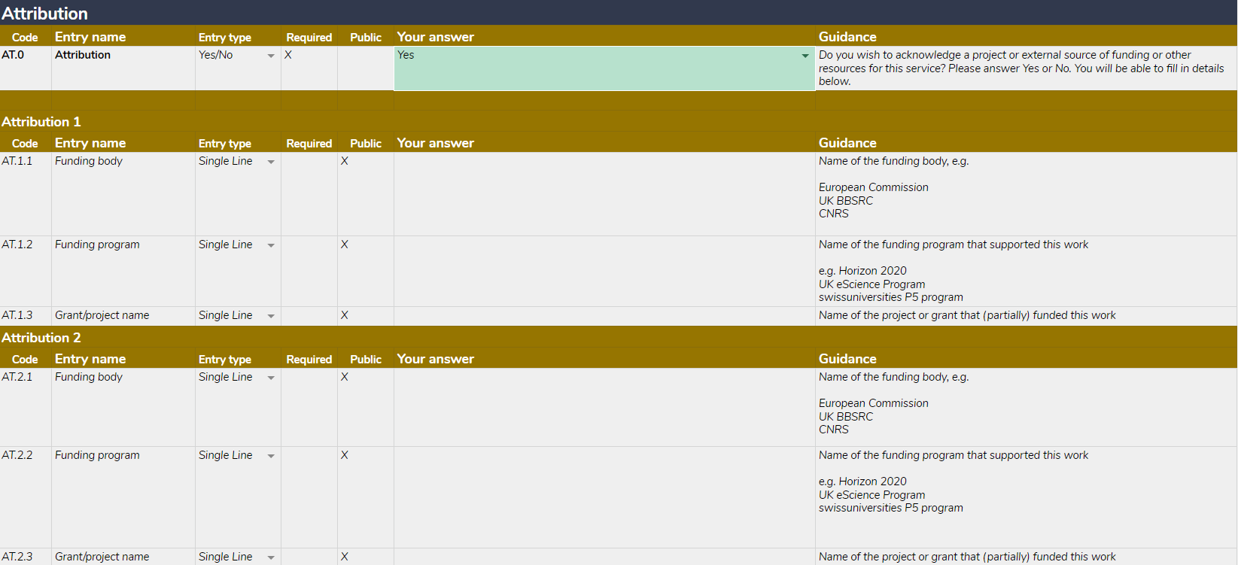
Attribution
View the SDT: bit.ly/EOSC-SDT-DEMO
Notes:
Highlights:
Trace impact of funding
Demonstrate value to funders
Connect to societal impacts

Slide 18
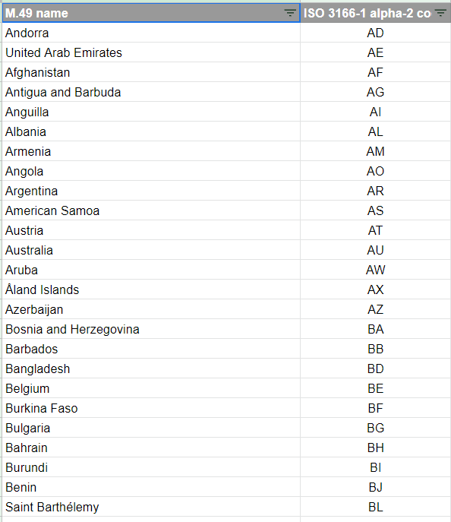
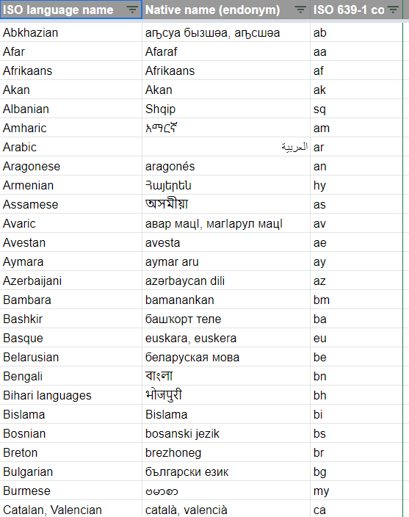
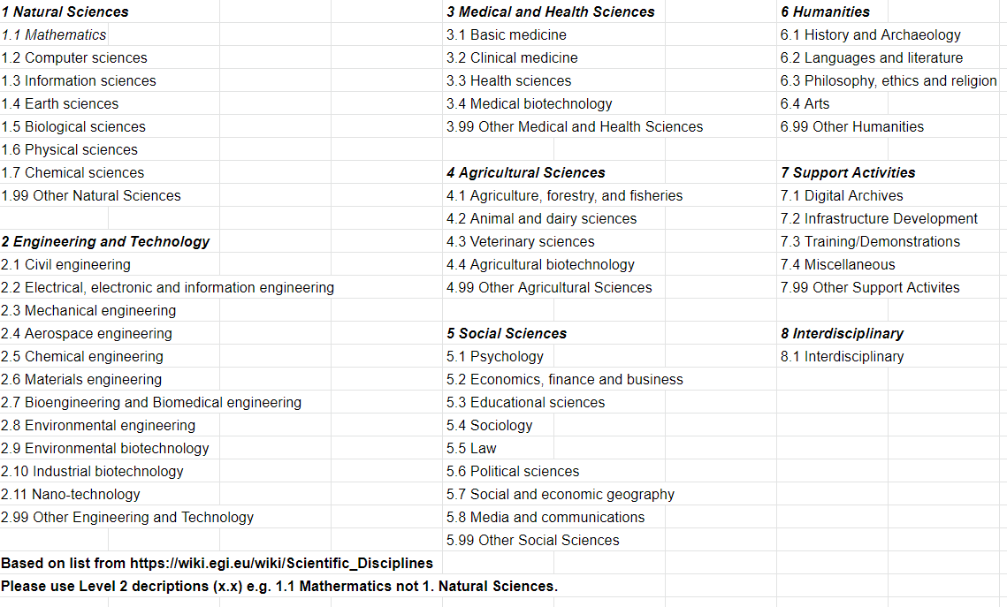
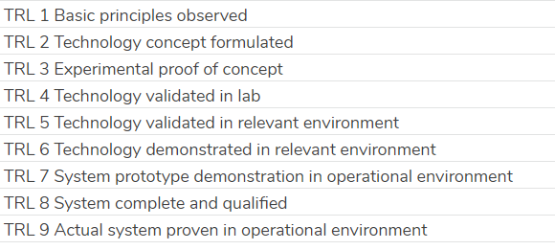
Supporting info
View the SDT: bit.ly/EOSC-SDT-DEMO

Slide 19
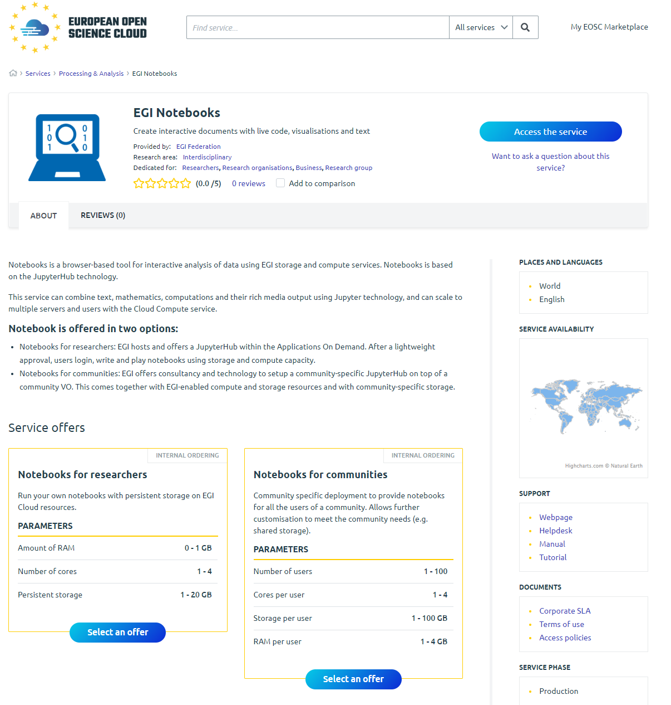
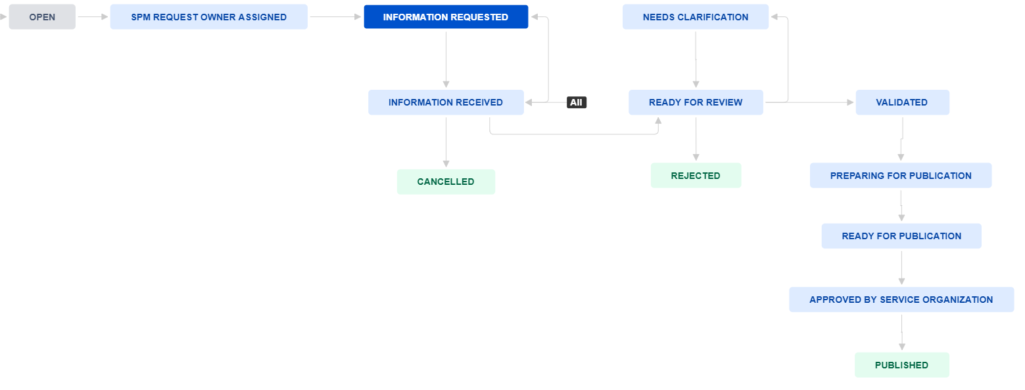
Publication
View the SDT: bit.ly/EOSC-SDT-DEMO

Slide 20
Maintenance of entries
Records need to be updated
Change to service
Change to profiles (SDTs)
Change to RoP
Current process is insufficient
Same work flow as adding a service, but skips some steps
Not currently clear enough, need new workflow
Removing services
Can retire on request
For suspension, informal process but with escalation path

Slide 21
Next steps
Forms
SDT 1.3.0 to Enhance Provider and Resource profiles 3.0
Future expansion to other resource types, work with OpenAIRE
Process
Update and removal process to be clarified
Joint onboarding with Enhance soon
Criteria and Rules
RoP 0.3 out soon, for further consultation
Further develop practical criteria, with community

Slide 22
EOSC Interest groups
EOSC Service and Research Product Catalogues Interest Group
https://www.eoscsecretariat.eu/service-research-product-catalogues
Platform for discussion of
Catalogues
Profiles
Onboarding
Material to be discussed
Provider and Resource profiles
Criteria for inclusion
Onboarding process

Slide 23
diego.scardaci@egi.eu

